Slide 1








Spring 2025 Annual Title I
Survey Results
Dallas Elementary

Slide 2


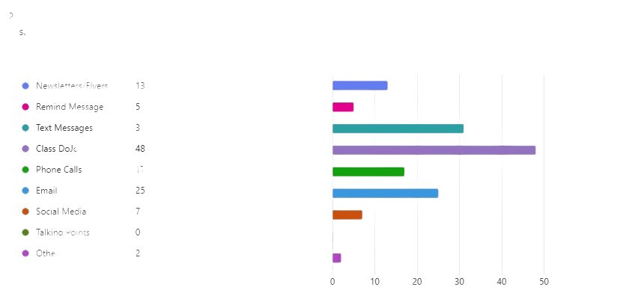
In what ways do you prefer to receive communication from your child's teacher and our school? Check all that applies.

Slide 3

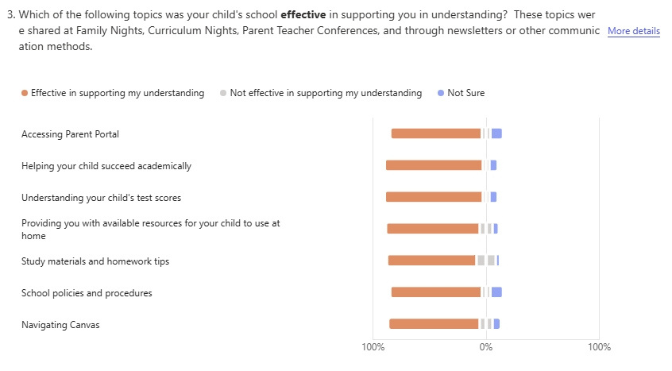
Which of the following topics was your child's school effective in supporting you in understanding? These topics were shared at Family Nights, Curriculum Nights, Parent Teacher Conferences, and through newsletters or other communication methods.

Slide 4

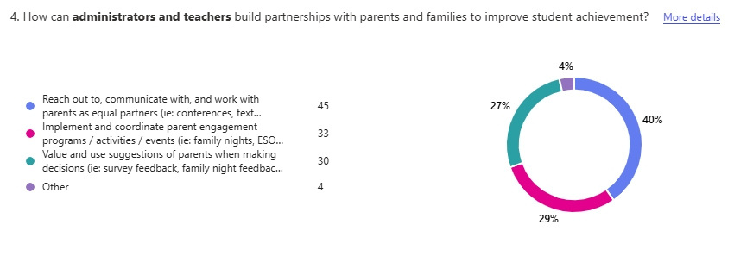


How can administrators and teachers build partnerships with parents and families to improve student achievement?

Slide 5
Our district and school have a Title I Parent Engagement Plan (which can be found on the school website and in the Parent Resource Center) that describes the activities that we offer to show families how to help their students at home. We believe that students do better when the school and families work together. In what ways can the school help better support you and your family?
  Effective Communication: Many parents find the current communication methods (Class DoJo, text messages, emails, phone calls) effective in supporting their understanding and engagement with the school.
  Event Timing: Evenings are the most convenient time for parents to attend family engagement events, though some parents mentioned that inconvenient event times and dates are a barrier to participation.
  Support and Resources: Parents appreciate programs that help them support their child's education, such as academic-related activities, strategies for math and reading, and resources for family engagement.
  Partnership and Feedback: Parents value being treated as equal partners and having their suggestions considered in school decisions. They appreciate the school's efforts to reach out and work with them through various engagement programs and activities.
  Additional Support: There is a desire for more resources and support, such as tutoring options, study materials for home practice, and better communication about available services and programs.

Slide 6
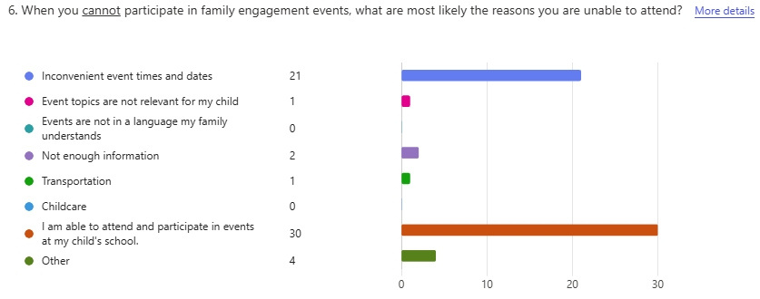


When you cannot participate in family engagement events, what are most likely the reasons you are unable to attend?

Slide 7
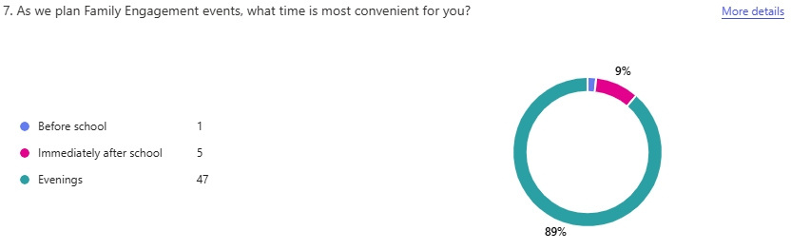
As we plan Family Engagement events, what time is most convenient for you?

Slide 8
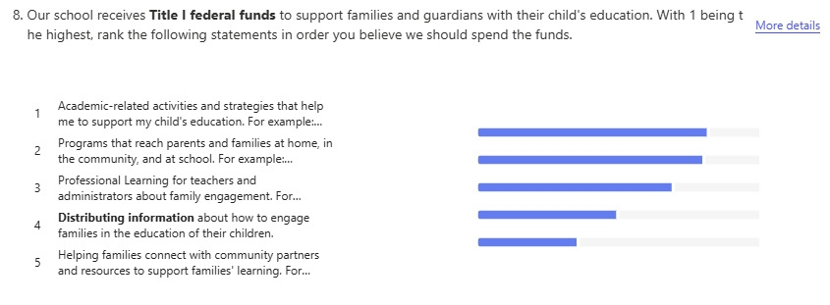
Our school receives Title I federal funds to support families and guardians with their child's education. With 1 being the highest, rank the following statements in order you believe we should spend the funds.

Slide 9
The School-Parent Compact (shared with you at Parent/Teacher Conferences, found on the school website and located in the Parent Resource Center) is a plan of action that outlines what the school, parents, and students need to do to help all students meet state education standards. What academic focus area do you want the school to work on with your child as we plan to write the School-Parent Compact for next year?
  Effective Communication: Parents appreciate the school's efforts to reach out and communicate with them as equal partners through various methods such as conferences, text messages, emails, phone calls, and meetings.
  Parent Engagement Programs: Implementing and coordinating parent engagement programs, activities, and events like family nights, ESOL Community Fair, and conferences are valued by parents.
  Consideration of Parent Feedback: Parents feel that their suggestions and feedback from surveys, family nights, and events are valued and used in making school decisions.
  Support for Academic Success: Parents suggest providing more resources and support for academic-related activities and strategies, such as math and reading strategies, test-taking tips, and summer learning programs.
  Community and Resource Connection: Helping families connect with community partners and resources, such as GED and English classes, technology support, and professional learning for teachers and administrators about family engagement, is appreciated by parents.

Slide 10
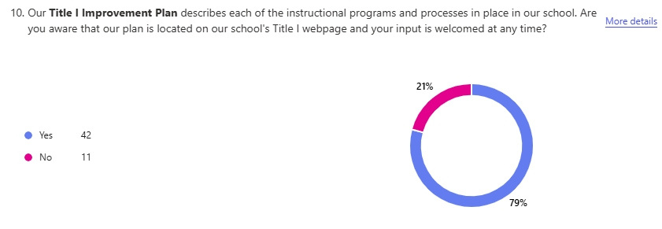
Our Title I Improvement Plan describes each of the instructional programs and processes in place in our school. Are you aware that our plan is located on our school's Title I webpage and your input is welcomed at any time?

